Slide 1
General Guidelines for Presentation
Slides should not be too heavy with content. Better to create point wise.
If you require more than one slide for any point, right click on that point slide then select duplicate slide and modify the duplicated slide.
Diagrams must be aligned at centre and clearly visible with caption.
All the mentioned fonts, font size, title content, etc should not change and strictly as per the given format and guidelines.

Slide 2

Skillup : A hub for certifications
Chitresh Poojary - 22107010
Ishan Rane - 22107052
Manish Khadtar - 22107039
Vinayak Kshirsagar - 22107046
Project Guide
Ms. Richa Singh

Slide 3
Contents
Introduction
Objectives
Scope
Features
Project Outcomes
Technology Stack
Block Diagram

Slide 4
1. Introduction
Problem Identified :
Delayed and error-filled submissions : Students often make delays and errors while submitting certificates
Complicated Review Process : Professors find it hard to manage and track certificate approvals
Solution Proposed :
Submission system : Students will use a single platform to upload certificates, reducing delays and errors
Review and Tracking : Professors will have a dedicated interface to easily manage and track certificate approvals

Slide 5
2. Objectives
To provide better student-mentor communication through mentor information.
To verify internships and cohort certificates through the faculty.
To improve the user experience for professors by allowing them to filter and view certificates based on their status.

Slide 6
3. Scope
Can be applied in academic institutions for managing internship certificates.
Can be useful to students for easy certificate submission and tracking.
Can be useful to professors for efficient certificate review and approval.

Slide 7
4. Feature
Certificate Upload :
Students can easily upload their internship certificates through the platform. The system ensures proper file handling.
Approval Dashboard :
Professors have access to a dashboard where they can approve submissions of certificates. This helps in managing and tracking submissions efficiently.
Notice Portal :
Students have access to a notice portal where students can they can check the deadlines for their internships
4. Mentor Mentee Portal :
Accessible Mentor Information for students

Slide 8
5. Outcome of Project
Students can log in to their accounts and upload internship certificates.
Professors can review and approve certificates through the dashboard.
Students can track the status of their certificate submissions.

Slide 9
6. Technology Stack
- Frontend : Java Swing (GUI)
- Backend : Java 22 version
- Database : MySQL

Slide 10
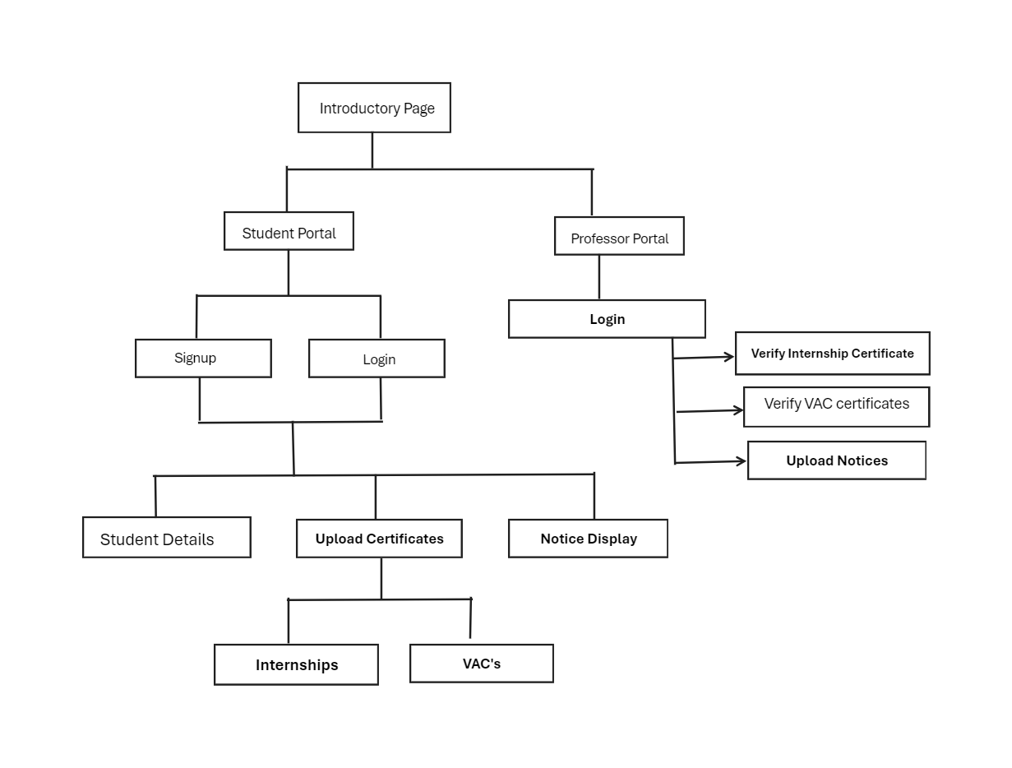
7. Block Diagram

Slide 11
Thank You...!!

